Slide 1
Basic Python
An overview of basic Python programming language and its features
Notes:
Entered text
Convert all these data into slide form
Here's a basic outline for a set of slides covering fundamental concepts in Python:
---
**Slide 1: Introduction to Python**
- Brief history of Python
- Why Python? (Versatility, readability, large community, etc.)
- Python 2 vs Python 3 (mention the transition)
**Slide 2: Installing Python**
- Downloading Python
- Installing Python on different platforms (Windows, macOS, Linux)
**Slide 3: Your First Python Program**
- Writing "Hello, World!" in Python
- Running Python scripts from the command line and IDLE
**Slide 4: Variables and Data Types**
- Variables and assignment
- Common data types: int, float, string, boolean
- Dynamic typing in Python
**Slide 5: Basic Operations**
- Arithmetic operators (+, -, *, /, %)
- Comparison operators (==, !=, >, <, >=, <=)
- Logical operators (and, or, not)
**Slide 6: Control Structures**
- if statements
- else and elif clauses
- Indentation in Python
**Slide 7: Loops**
- for loops
- while loops
- Loop control statements (break, continue)
**Slide 8: Data Structures**
- Lists
- Tuples
- Dictionaries
- Sets
**Slide 9: Functions**
- Defining functions
- Parameters and arguments
- Return statement
**Slide 10: Modules and Packages**
- Importing modules
- Creating your own modules
- Installing packages using pip
**Slide 11: Error Handling**
- Exception handling with try and except
- Handling specific exceptions
- finally block
**Slide 12: File Handling**
- Opening and closing files
- Reading from and writing to files
- Using 'with' statement for file handling
**Slide 13: Object-Oriented Programming (OOP)**
- Classes and objects
- Attributes and methods
- Inheritance
**Slide 14: Advanced Topics**
- List comprehensions
- Lambda functions
- Generators
- Decorators
**Slide 15: Resources**
- Online tutorials and documentation
- Recommended books
- Python community forums and websites
**Slide 16: Conclusion**
- Summary of key points
- Encouragement to practice and explore further
---
This outline covers the basics comprehensively. Each slide can include bullet points, code snippets, and possibly diagrams to illustrate the concepts. Let me know if you'd like more detailed content for any specific slide!

Slide 2
Slides for Basic Concepts in Python
A set of slides covering fundamental concepts in Python, from installation to advanced topics. These slides cover the history and advantages of Python, installing Python on different platforms, writing Python scripts including 'Hello, World!', Python's variables and datatypes, basic operations, control structures, loops, data structures, functions, modules and packages, error handling, file handling, object-oriented programming, advanced topics such as list comprehension and lambda functions, and resources for learning and exploring Python.

Slide 3
Introduction to Python
Easy to read and write
High-level programming language
General-purpose language
Interpreted language

Slide 4
Python Variables
No need to specify variable type
Automatic memory allocation
Dynamic typing
Variables can hold any type of data

Slide 5
Python Data Types
Integer
Float
String
List
Tuple
Dictionary

Slide 6
Python Control Structures
Conditional statements
Looping statements
Ifelse statement
For loop
While loop

Slide 7
Python Functions
Function parameters
Reusable blocks of code
Modular programming
Function return values

Slide 8
Python Modules
Code written in separate files
Imported and used in other programs
Encourages code reusability
Standard library modules

Slide 9
Python File Handling
Parsing and manipulating data files
Reading and writing files
Operating system file operations

Slide 10
Python Exception Handling
Try-except blocks
Catching and handling runtime errors
Preventing program crashes
Handling multiple exceptions

Slide 11
Python Libraries
Vast collection of libraries
Extend Python's functionality
Pandas for data analysis
NumPy for numerical computations
Matplotlib for data visualization

Slide 12
Conclusion
Python is a versatile and powerful language
Ideal for beginners and experienced programmers
Its simplicity and readability make it popular
Used in various domains like web development, data analysis, machine learning

Slide 13

Introduction to Python
Python 2 vs Python 3 (mention the transition)
Brief history of Python
Why Python? (Versatility, readability, large community, etc.)

Slide 14
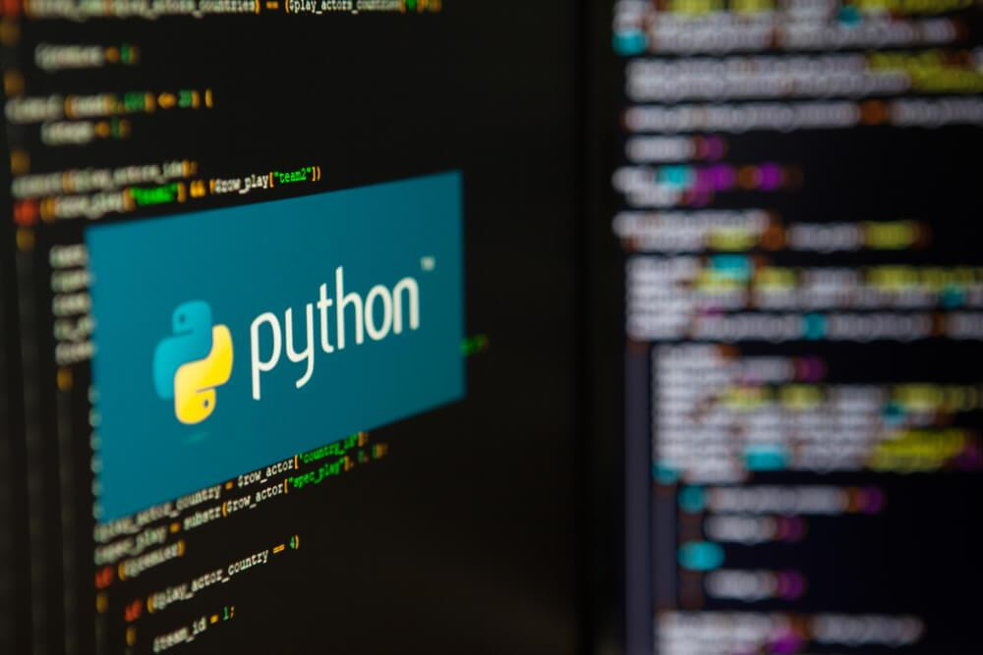
Installing Python
Downloading Python
Installing Python on different platforms (Windows, macOS, Linux)

Slide 15

Your First Python Program
Running Python scripts from the command line and IDLE
Writing "Hello, World!" in Python

Slide 16
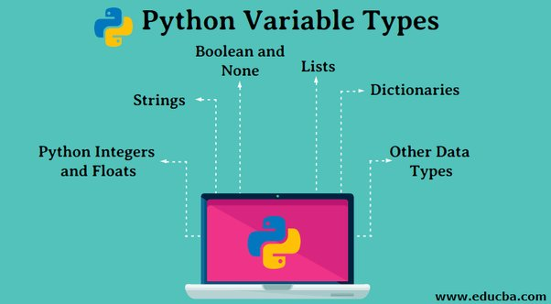
Variables and Data Types
Variables and assignment
Common data types: int, float, string, boolean
Dynamic typing in Python

Slide 17
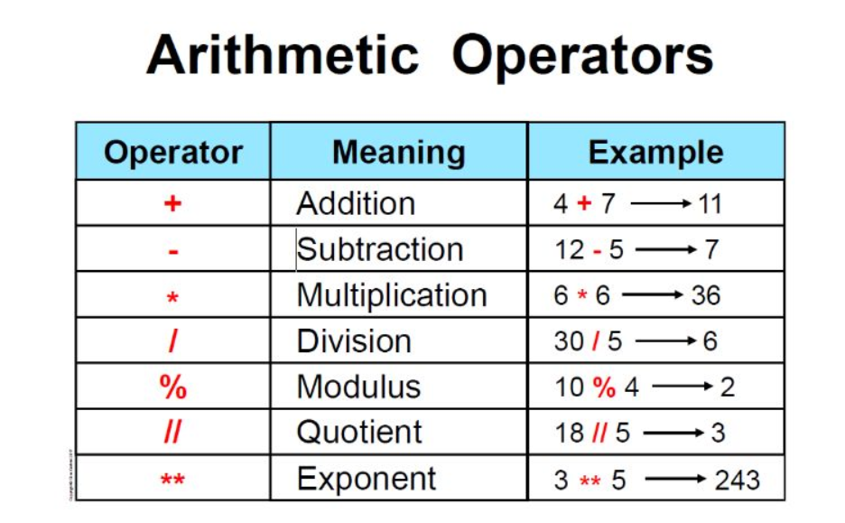
Basic Operations
Logical operators (and, or, not)
Arithmetic operators (+, -, *, /, %)
Comparison operators (==, !=, >, <, >=, <=)

Slide 18
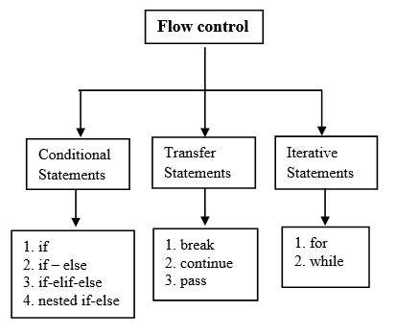
Control Structures
if statements
else and elif clauses
Indentation in Python

Slide 19
Loops
Loop control statements (break, continue)
for loops
while loops

Slide 20
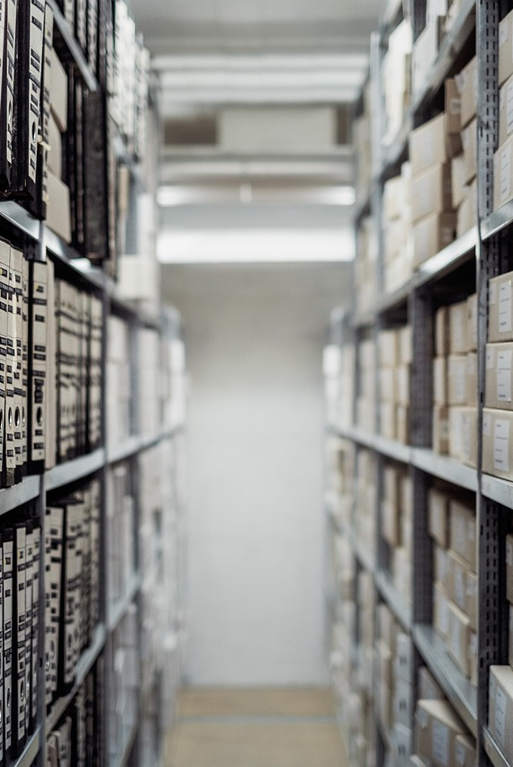
Data Structures
Lists
Tuples
Dictionaries
Sets

Slide 21

Functions
Return statement
Defining functions
Parameters and arguments

Slide 22
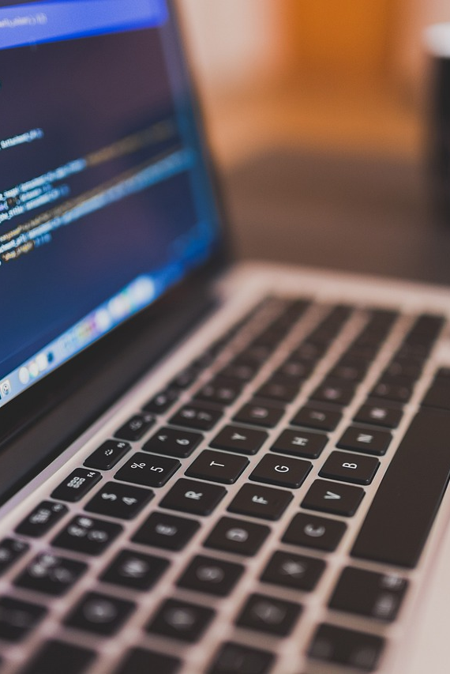
Modules and Packages
Importing modules
Creating your own modules
Installing packages using pip

Slide 23
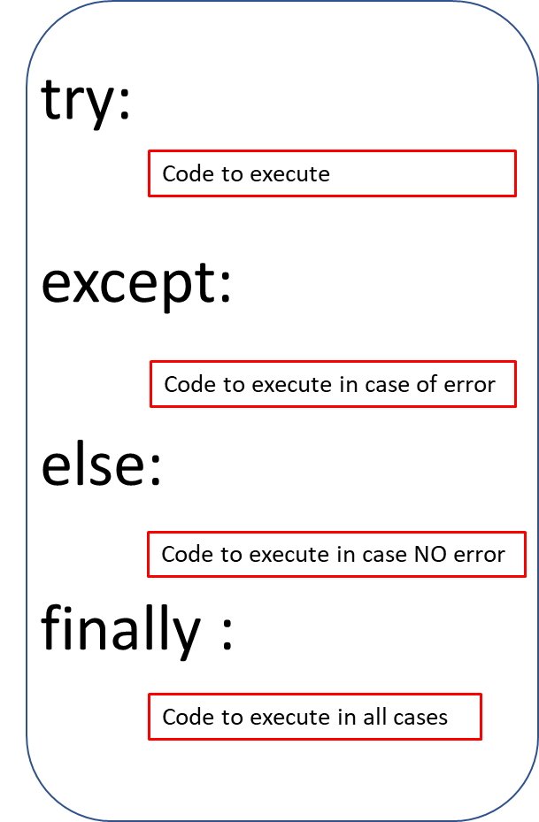
Error Handling
finally block
Exception handling with try and except
Handling specific exceptions

Slide 24
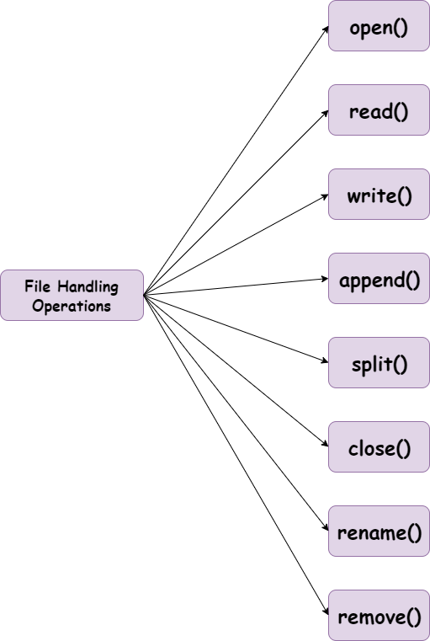
File Handling
Opening and closing files
Reading from and writing to files
Using 'with' statement for file handling

Slide 25
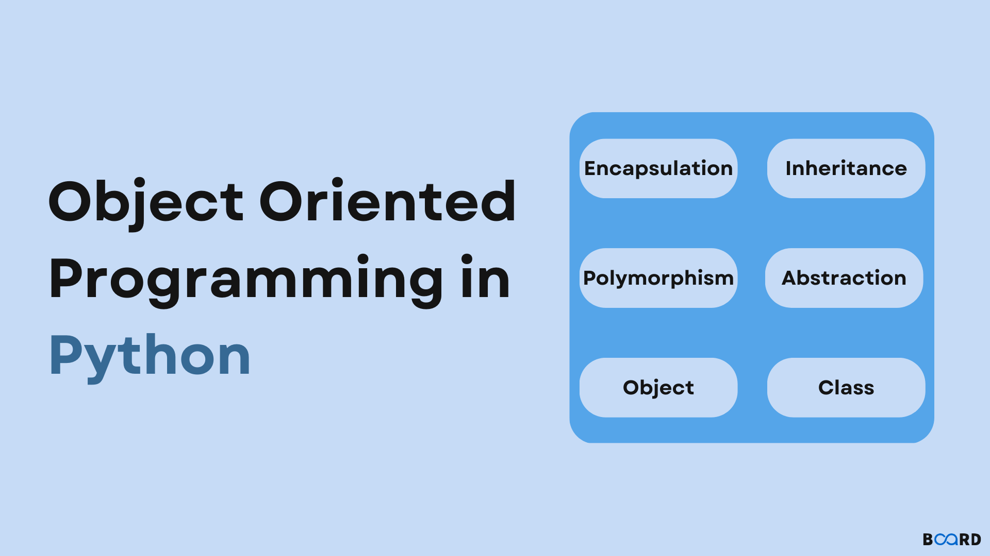
Object-Oriented Programming (OOP)
Inheritance
Classes and objects
Attributes and methods

Slide 26
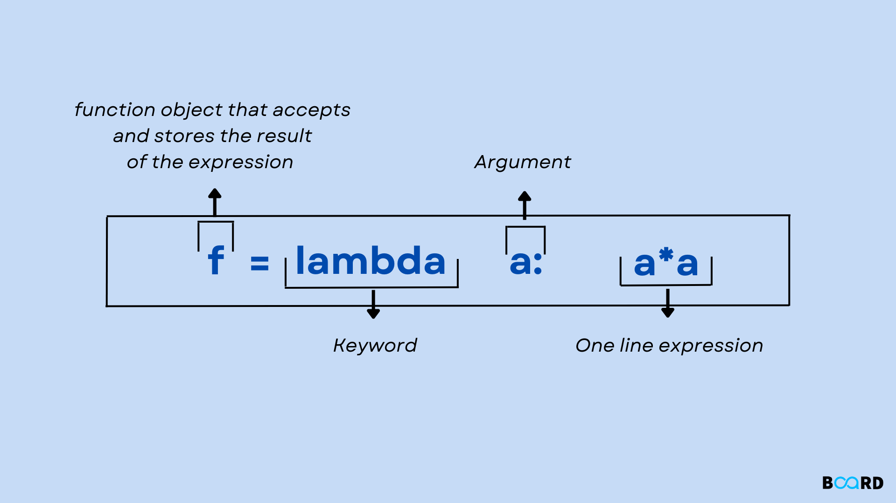
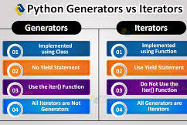
Advanced Topics
List comprehensions
Lambda functions
Generators
Decorators

Slide 27
Conclusion
This outline covers the basics comprehensively. Each slide can include bullet points, code snippets, and possibly diagrams to illustrate the concepts. Let me know if you'd like more detailed content for any specific slide!
Summary of key points
Encouragement to practice and explore further

Slide 28
Thank you for your time and attention 🙂

